Slide 1
Database Systems:
Theory and Programming
Normalization
“Errors using inadequate data are much less
than those using no data at all."
Charles Babbage
Originater of the concept of a digital
programmable computer
Notes:
Replace this with your course title and your name/contact details.

Slide 2
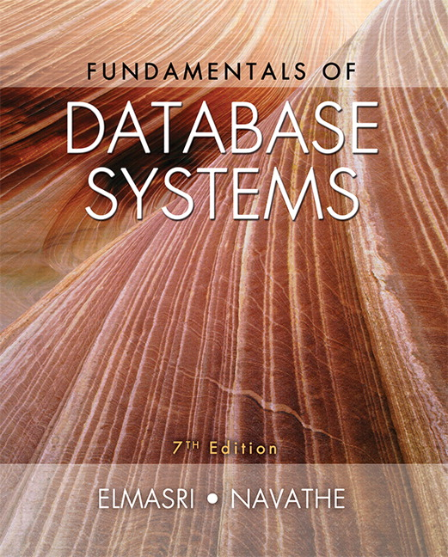
Database Systems:
Theory and Programming
Chapter 14
Basics of Functional Dependencies and Normalization for Relational Databases

Slide 3
Functional Dependencies

Slide 4
Functional Dependencies
Functional dependencies (FDs)
  Are used to specify formal measures of the "goodness" of relational designs
  And keys are used to define normal forms for relations
  Are constraints that are derived from the meaning and interrelationships of the data attributes
A set of attributes X functionally determines a set of attributes Y if the value of X determines a unique value for Y

Slide 5
Defining Functional Dependencies
X  Y holds if whenever two tuples have the same value for X, they must have the same value for Y
  For any two tuples t1 and t2 in any relation instance r(R):
  If t1[X]=t2[X], then t1[Y]=t2[Y]
X  Y in R specifies a constraint on all relation instances r(R)
Written as X  Y; can be displayed graphically on a relation schema
FDs are derived from the real-world constraints on the attributes

Slide 6
Examples of FD constraints
Social security number determines employee name
  SSN  ENAME
Project number determines project name and location
  PNUMBER  {PNAME, PLOCATION}
Employee ssn and project number determines the hours per week that the employee works on the project
  {SSN, PNUMBER}  HOURS
An FD is a property of the attributes in the schema R
The constraint must hold on every relation instance r(R)
If K is a key of R, then K functionally determines all attributes in R
  (since we never have two distinct tuples with t1[K]=t2[K])

Slide 7
Defining FDs from instances
Note that in order to define the FDs, we need to understand the meaning of the attributes involved and the relationship between them.
An FD is a property of the attributes in the schema R
Given the instance (population) of a relation, all we can conclude is that an FD may exist between certain attributes.
What we can definitely conclude is – that certain FDs do not exist because there are tuples that show a violation of those dependencies.

Slide 8
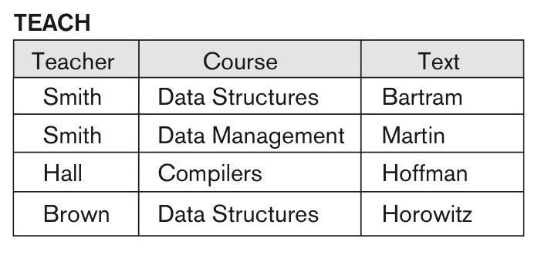
Ruling Out FDs
Note that given the state of the TEACH relation, we can say that the
FD: Text → Course may exist.
However, the FDs
  Teacher → Course,
  Teacher → Text and
  Couse → Text
  are ruled out.

Slide 9
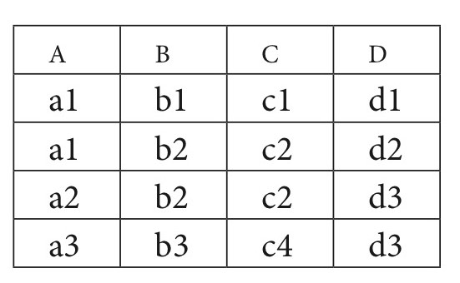
What FDs may exist?
A relation R(A, B, C, D) with its extension.
Which FDs may exist in this relation?
Which FDs cannot exist in this relation?
B → C
C → B
{A, B} → C
{A, B} → D
{C, D} → B
{C, D} → A
{A, C} → D
etc.
A → B
B → A
D → C
etc.

Slide 10
Decomposition and lossy joins

Slide 11
Decomposition
Goal
  Eliminate redundancy by decomposing a relation into several relations in a higher normal form.
  It is important to check that a decomposition does not lead to bad design
Problem
  However, there are rules to proper decomposition of relations.
  Otherwise, we may not be able to reconstruct the corresponding instance of the original relation – information loss

Slide 12
Example : Problem with Decomposition
R
Model Name | Price | Category
a11 | 100 | Canon
s20 | 200 | Nikon
a70 | 150 | Canon
R1
R2
Model Name | Category
a11 | Canon
s20 | Nikon
a70 | Canon
Price | Category
100 | Canon
200 | Nikon
150 | Canon

Slide 13
Example : Problem with Decomposition
R1 join R2
Model Name | Price | Category
a11 | 100 | Canon
a11 | 150 | Canon
s20 | 200 | Nikon
a70 | 100 | Canon
a70 | 150 | Canon
Additional tuples are obtained along with original tuples
Although there are more tuples, this leads to less information
Due to the loss of information, decomposition for previous example is called lossy decomposition or lossy-join decomposition
R
Model Name | Price | Category
a11 | 100 | Canon
s20 | 200 | Nikon
a70 | 150 | Canon

Slide 14
Lossy decomposition (example 2)
T
Employee | Project | Branch
Brown | Mars | L.A.
Green | Jupiter | San Jose
Green | Venus | San Jose
Hoskins | Saturn | San Jose
Hoskins | Venus | San Jose
Functional dependencies:
Employee Branch, Project Branch

Slide 15
Lossy decomposition
Decomposition of the previous relation
T1
T2
Employee | Branch
Brown | L.A
Green | San Jose
Hoskins | San Jose
Project | Branch
Mars | L.A.
Jupiter | San Jose
Saturn | San Jose
Venus | San Jose

Slide 16
Lossy decomposition
After Natural Join
Original Relation
Employee | Project | Branch
Brown | Mars | L.A.
Green | Jupiter | San Jose
Green | Venus | San Jose
Hoskins | Saturn | San Jose
Hoskins | Venus | San Jose
Green | Saturn | San Jose
Hoskins | Jupiter | San Jose
Employee | Project | Branch
Brown | Mars | L.A.
Green | Jupiter | San Jose
Green | Venus | San Jose
Hoskins | Saturn | San Jose
Hoskins | Venus | San Jose
After Natural Join, we get two extra tuples. Thus, there is loss of information.

Slide 17
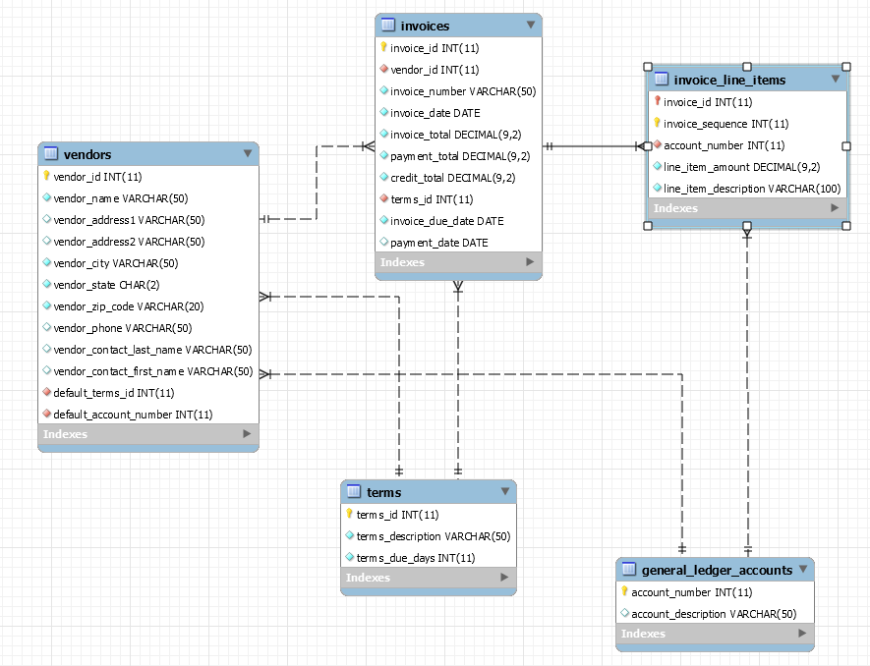
How many ways are there to get from Invoice to General_Ledger_Account
Vendor “IRT Computers” almost always provides servers which are considered applicable to the “Capitalized Assets” general ledger account
But what if IRT Computers offered a one-off consulting services, applicable to the “Consulting” general ledger account?
How did the DB designers solve this “natural join” problem?

Slide 18
Design Guidelines

Slide 19
Semantics of the Relational Attributes must be clear
GUIDELINE 1: Informally, each tuple in a relation should represent one entity or relationship instance. (Applies to individual relations and their attributes).
  Attributes of different entities (EMPLOYEEs, DEPARTMENTs, PROJECTs) should not be mixed in the same relation
  Only foreign keys should be used to refer to other entities
  Entity and relationship attributes should be kept apart as much as possible.
Bottom Line: Design a schema that can be explained easily relation by relation. The semantics of attributes should be easy to interpret.

Slide 20
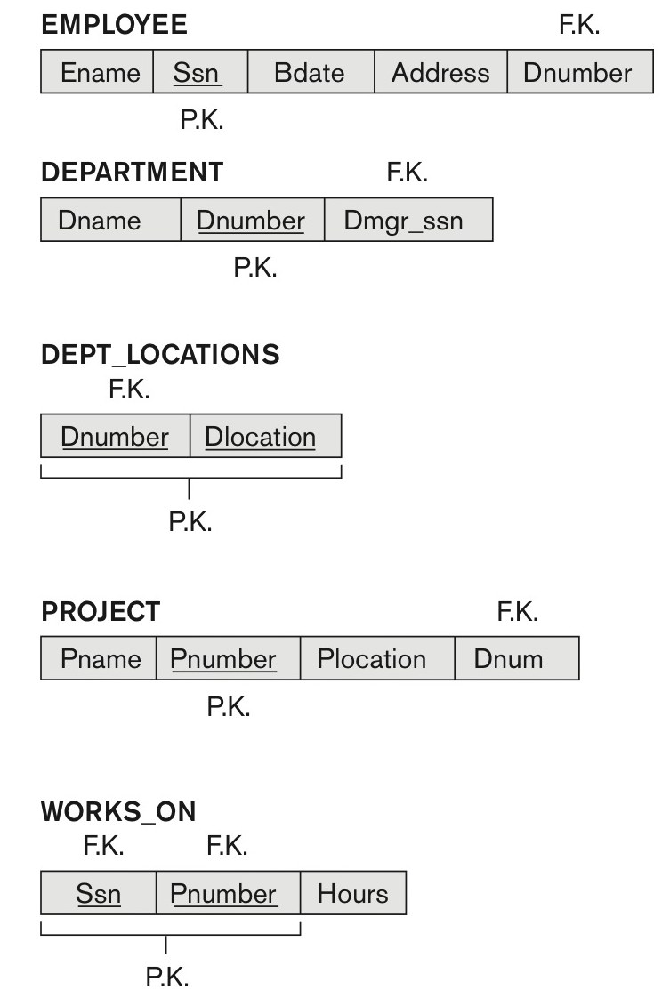
Figure 14.1 A simplified COMPANY relational database schema
Figure 14.1 A simplified COMPANY relational database schema.

Slide 21
Redundant Information in Tuples and Update Anomalies
Information is stored redundantly
  Wastes storage
  Causes problems with update anomalies
    Insertion anomalies
    Deletion anomalies
    Modification anomalies

Slide 22
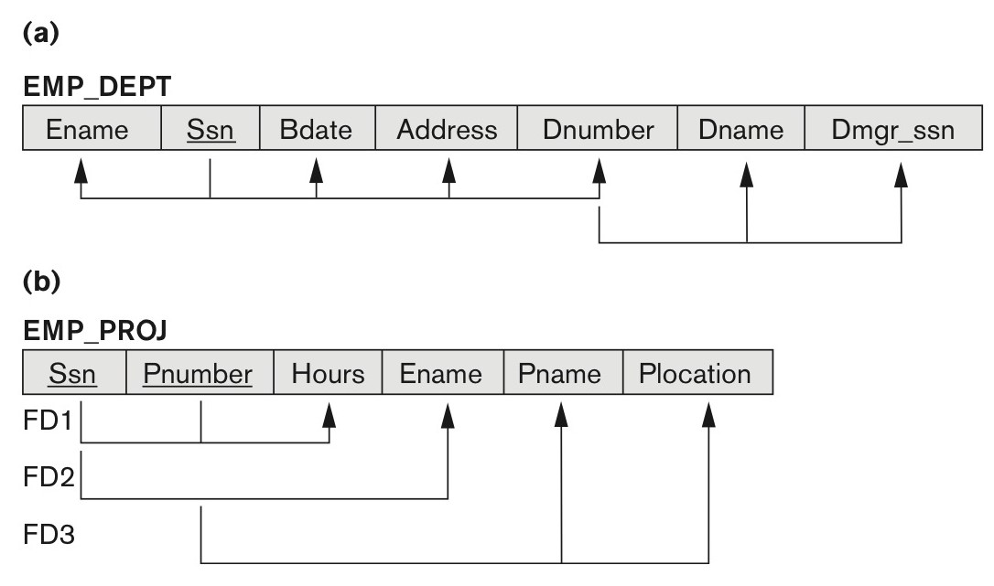
Figure 14.3 Two relation schemas suffering from update anomalies
Figure 14.3
Two relation schemas suffering from update anomalies. (a) EMP_DEPT and (b) EMP_PROJ.

Slide 23
EXAMPLE OF A MODIFICATION ANOMALY
Changing the manager of department 5?
Well, you better change it multiple times!

Slide 24
EXAMPLE OF AN INSERT ANOMALY
Insert a new employee for department 5?
Well, you better make sure the name for department 5 is consistent

Slide 25
EXAMPLE OF A DELETE ANOMALY
Deleting the last employee in department 5?
Whoops, department 5 is gone as well!

Slide 26
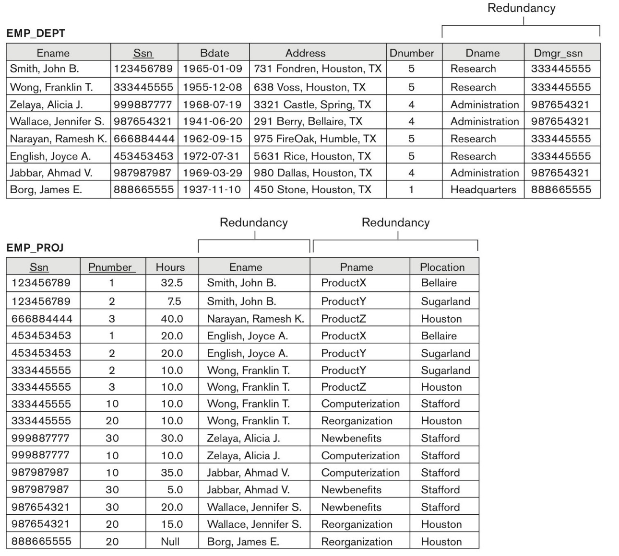
Figure 14.4 Sample states for EMP_DEPT and EMP_PROJ
Figure 14.4
Sample states for EMP_DEPT and EMP_PROJ resulting from applying NATURAL JOIN to the relations in Figure 14.2. These may be stored as base relations for performance reasons.

Slide 27
Guideline for Redundant Information in Tuples and Update Anomalies
GUIDELINE 2:
  Design a schema that does not suffer from the insertion, deletion and update anomalies.
  If there are any anomalies present, then note them so that applications can be made to take them into account.

Slide 28
Null Values in Tuples
GUIDELINE 3:
  Relations should be designed such that their tuples will have as few NULL values as possible
  Attributes that are NULL frequently could be placed in separate relations (with the primary key)
Reasons for nulls:
  Attribute not applicable or invalid
  Attribute value unknown (may exist)
  Value known to exist, but unavailable

Slide 29
Generation of Spurious Tuples
– avoid at any cost
Bad designs for a relational database may result in erroneous results for certain JOIN operations
The "lossless join" property is used to guarantee meaningful results for join operations
GUIDELINE 4:
  The relations should be designed to satisfy the lossless join condition.
  No spurious tuples should be generated by doing a natural-join of any relations.

Slide 30
Spurious Tuples
There are two important properties of decompositions:
  Non-additive or losslessness of the corresponding join
  Preservation of the functional dependencies.
Note that:
  Property (a) is extremely important and cannot be sacrificed.
  Property (b) is less stringent and may be sacrificed.

Slide 31
Normalization

Slide 32
Normalization of Relations
Normalization:
  The process of decomposing unsatisfactory "bad" relations by breaking up their attributes into smaller relations
Normal form:
  Condition using keys and FDs of a relation to certify whether a relation schema is in a particular normal form

Slide 33
Practical Use of Normal Forms
Normalization is carried out in practice so that the resulting designs are of high quality and meet the desirable properties
The practical utility of these normal forms becomes questionable when the constraints on which they are based are hard to understand or to detect
The database designers need not normalize to the highest possible normal form
  (usually up to 3NF and BCNF. 4NF rarely used in practice.)
Denormalization:
  The process of storing the join of higher normal form relations as a base relation—which is in a lower normal form

Slide 34
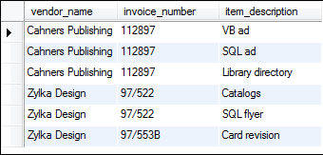
The Goals of Normalization
First Goal:
Eliminate
redundant
data.
Second Goal: Ensure data dependencies make sense
Dependency (two ways to think of it.)
  B is dependent on A, if for each B there is one and only possibility for A.
  B is dependent on A, if B uniquely determines A.
  B → A

Slide 35
Benefits of Normalization
Less data inconsistency
Data redundancy is minimized, which simplifies maintenance and reduces storage.
Clearer data relationships
Flexible data structure
More tables, and each table has an index on its primary key. That makes data retrieval more efficient.
Each table contains information about a single entity. That makes data retrieval and insert, update, and delete operations more efficient.
Each table has fewer indexes, which makes insert, update, and delete operations more efficient.

Slide 36
Normalization to BCNF
1NF
  A table is of 1st Normal Form if all the columns of a table are atomic, that is, they do not consist of subparts AND
  There are no repeating columns of associated data.
2NF
  It is in 1st Normal Form AND
  No non-prime attribute is dependent on any proper subset of any candidate key of the table.
3NF
  It is in 2nd Normal Form AND
  Every non-prime attribute is directly dependent on every candidate key of the table.
  "Every non-key attribute must provide a fact about the key, the whole key, and nothing but the key, so help me Codd"
BCNF
  It is in 3rd Normal Form AND
  If every determinant is a candidate key.
    The definition of 3NF does not deal with a
    relation that has multiple candidate keys, where:
    those candidate keys are composite, and
    the candidate keys overlap
    (i.e., have at least one common attribute)
Non-prime attribute: any attribute that is not part of any candidate key of the table.
Determinant: factor which defines a condition. For instance in functional dependency A, B → C, the set A, B is the determinant.

Slide 37
1st Normal Form
A table is of 1st Normal Form if all the columns of a table are atomic, that is, they do not consist of subparts AND
There are no repeating columns of associated data.
Is this table 1NF?
No, you have repeating authors.
Title | Authors | Pub Date | Keywords
Making Use of Ruby | Mahadevan | 2002 | Ruby
Objects First with Java | Barnes, Kolling | 2009 | Java
Programming Ruby | Thomas, Fowler, Hunt | 2005 | Ruby
HTML5 and CSS3 | Ruvalcaba, Boehm | 2012 | HTML5, CSS

Slide 38
Converting to 1NF
Title | Authors | Pub Date | Keywords
Making Use of Ruby | Mahadevan | 2002 | Ruby
Objects First with Java | Barnes, Kolling | 2009 | Java
Programming Ruby | Thomas, Fowler, Hunt | 2005 | Ruby
HTML5 and CSS3 | Ruvalcaba, Boehm | 2012 | HTML5, CSS
Title | Authors | Pub Date | Keywords
Making Use of Ruby | Mahadevan | 2002 | Ruby
Objects First with Java | Barnes | 2009 | Java
Objects First with Java | Kolling | 2009 | Java
Programming Ruby | Thomas | 2005 | Ruby
Programming Ruby | Fowler | 2005 | Ruby
Programming Ruby | Hunt | 2005 | Ruby
HTML5 and CSS3 | Ruvalcaba | 2012 | HTML5
HTML5 and CSS3 | Boehm | 2012 | HTML5
HTML5 and CSS3 | Ruvalcaba | 2012 | CSS
HTML5 and CSS3 | Boehm | 2012 | CSS

Slide 39
1st Normal Form
A table is of 1st Normal Form if all the columns of a table are atomic, that is, they do not consist of subparts AND
There are no repeating columns of associated data.
Is this table 1NF?
Title | Author1 | Author2 | Author3 | Pub Date | Keywords
Making Use of Ruby | Mahadevan | Kolling |  | 2002 | Ruby
Objects First with Java | Barnes |  |  | 2009 | Java
Programming Ruby | Thomas | Fowler | Hunt | 2005 | Ruby
HTML5 and CSS3 | Ruvalcaba | Boehm |  | 2012 | HTML5, CSS

Slide 40
1st Normal Form Can Spark Debates
"On the Waterfront" : atomic?
01-April-2013 : atomic?
"Nicole Kidman" : atomic?

Slide 41

Another 1NF Example

Slide 42
2nd Normal Form
Non-prime attribute: Any attribute that is not part of any candidate key of the table
A table is in 2nd Normal Form if:
  It is in 1st Normal Form AND
  No non-prime attribute is dependent on any proper subset of any candidate key of the table.
There is no partial dependency in 2NF.

Slide 43
An Example
Products table. Is this in 1NF? In 2NF?
Manufacturer | Brand | Size | List Price | Manufacturer_HQ_City | Manufacturer_HQ_State
ShopRite | Chocolate Sandwich Cremes | 13 oz. | 1.99 | Wethersfield | CT
Grandma's | Chocolate Sandwich Cremes | 13 oz. | 2.49 | Dallas | TX
Quaker | Apple Cinnamon Rice Cakes | 6 oz. | 1.99 | Chicago | IL
ShopRite | Apple Cinnamon Rice Cakes | 6 oz. | 1.59 | Wethersfield | CT
ShopRite | Apple Sauce | 25 oz | 1.79 | Wethersfield | CT
Musselman's | Apple Sauce | 25 oz. | 2.19 | Peach Glen | PA
White House | Apple Sauce | 25 oz. | 2.59 | Winchester | VA
Grandma's | Vanilla Sandwich Cremes | 13 oz. | 2.49 | Dallas | TX
Not atomic. Size is composed of weight and units.

Slide 44
An Example
Products table. Is this in 1NF? In 2NF?
Candidate Key
Manufacturer | Brand | Weight | List Price | Manufacturer_HQ_City | Manufacturer_HQ_State
ShopRite | Chocolate Sandwich Cremes | 13 | 1.99 | Wethersfield | CT
Grandma's | Chocolate Sandwich Cremes | 13 | 2.49 | Dallas | TX
Quaker | Apple Cinnamon Rice Cakes | 6 | 1.99 | Chicago | IL
ShopRite | Apple Cinnamon Rice Cakes | 6 | 1.59 | Wethersfield | CT
ShopRite | Apple Sauce | 25 | 1.79 | Wethersfield | CT
Musselman's | Apple Sauce | 25 | 2.19 | Peach Glen | PA
White House | Apple Sauce | 25 | 2.59 | Winchester | VA
Grandma's | Vanilla Sandwich Cremes | 13 | 2.49 | Dallas | TX
These columns depend on a subset of the candidate key, namely Manufacturer. Not in 2NF.

Slide 45
A 2NF Representation
Manufacturer | Brand | Weight | List Price
ShopRite | Chocolate Sandwich Cremes | 13 | 1.99
Grandma's | Chocolate Sandwich Cremes | 13 | 2.49
Quaker | Apple Cinnamon Rice Cakes | 6 | 1.99
ShopRite | Apple Cinnamon Rice Cakes | 6 | 1.59
ShopRite | Apple Sauce | 25 | 1.79
Musselman's | Apple Sauce | 25 | 2.19
White House | Apple Sauce | 25 | 2.59
Grandma's | Vanilla Sandwich Cremes | 13 | 2.49
Separate those attributes that depend on a subset of the key (i.e., Manufacturer) into their own table.
Manufacturer | Manufacturer_HQ_City | Manufacturer_HQ_State
ShopRite | Wethersfield | CT
Grandma's | Dallas | TX
Quaker | Chicago | IL
Musselman's | Peach Glen | PA
White House | Winchester | VA

Slide 46
3rd Normal Form
Non-prime attribute: Any attribute that is not part of any candidate key of the table
A table is in 3rd Normal Form if:
  It is in 2nd Normal Form AND
  Every non-prime attribute is directly dependent on every candidate key of the table.
  "Every non-key attribute must provide a fact about the key, the whole key, and nothing but the key, so help me Codd"
  (Computer scientist E.F. Codd first described the normal forms.)
REMOVE columns not dependent on the primary key.

Slide 47
3NF or not? (1)
Manufacturer | Brand | Weight | List Price
ShopRite | Chocolate Sandwich Cremes | 13 | 1.99
Grandma's | Chocolate Sandwich Cremes | 13 | 2.49
Quaker | Apple Cinnamon Rice Cakes | 6 | 1.99
ShopRite | Apple Cinnamon Rice Cakes | 6 | 1.59
ShopRite | Apple Sauce | 25 | 1.79
Musselman's | Apple Sauce | 25 | 2.19
Claymont | Apple Sauce | 25 | 2.59
Grandma's | Vanilla Sandwich Cremes | 13 | 2.49
Are these tables in 3NF?
Table 1: Yes. List Price depends directly on Manufacturer, Brand and Weight.
Manufacturer | Manufacturer_HQ_City | Manufacturer_HQ_State
ShopRite | Wethersfield | CT
Grandma's | Dallas | TX
Quaker | Chicago | IL
Musselman's | Peach Glen | PA
Claymont | Dallas | TX

Slide 48
3NF or not? (2)
Manufacturer | Brand | Weight | List Price
ShopRite | Chocolate Sandwich Cremes | 13 | 1.99
Grandma's | Chocolate Sandwich Cremes | 13 | 2.49
Quaker | Apple Cinnamon Rice Cakes | 6 | 1.99
ShopRite | Apple Cinnamon Rice Cakes | 6 | 1.59
ShopRite | Apple Sauce | 25 | 1.79
Musselman's | Apple Sauce | 25 | 2.19
Claymont | Apple Sauce | 25 | 2.59
Grandma's | Vanilla Sandwich Cremes | 13 | 2.49
Table 2? Does HQ State directly depend on Manufacturer or HQ City?
In 3NF. Consider Philadelphia, TN or Philadelphia, MS
Manufacturer | Manufacturer_HQ_City | Manufacturer_HQ_State
ShopRite | Wethersfield | CT
Grandma's | Dallas | TX
Quaker | Chicago | IL
Musselman's | Peach Glen | PA
Claymont | Dallas | TX

Slide 49
Another Example (1)
Tournament | Year | Winner | Winner Nation
Wimbledon | 2012 | Federer | Switzerland
US Open | 2012 | Murray | UK
Wimbledon | 2011 | Djokovic | Serbia
US Open | 2011 | Djokovic | Serbia
Wimbledon | 2010 | Nadal | Spain
US Open | 2010 | Nadal | Spain
Wimbledon | 2009 | Federer | Switzerland
US Open | 2009 | Del Potro | Argentina
1NF or not?
Yes, all
attributes
are atomic
2NF or not?
Yes, no
non-prime
attribute is
dependent
on a subset
of the key
(Tournament, Year)

Slide 50
Another Example (2)
Tournament | Year | Winner | Winner Nation
Wimbledon | 2012 | Federer | Switzerland
US Open | 2012 | Murray | UK
Wimbledon | 2011 | Djokovic | Serbia
US Open | 2011 | Djokovic | Serbia
Wimbledon | 2010 | Nadal | Spain
US Open | 2010 | Nadal | Spain
Wimbledon | 2009 | Federer | Switzerland
US Open | 2009 | Del Potro | Argentina
3NF or not?
Nope. While Winner does directly depend on Tournament and Year, Winner Nation only indirectly depends on the key, but directly depends on Winner .
Every non-key attribute must provide a fact about the key, the whole key, and nothing but the key, so help me Codd.

Slide 51
Another Example (3)
Tournament Key | Tournament | Year | Winner | Winner Nation
1 | Wimbledon | 2012 | Federer | Switzerland
2 | US Open | 2012 | Murray | UK
3 | Wimbledon | 2011 | Djokovic | Serbia
4 | US Open | 2011 | Djokovic | Serbia
5 | Wimbledon | 2010 | Nadal | Spain
6 | US Open | 2010 | Nadal | Spain
7 | Wimbledon | 2009 | Federer | Switzerland
8 | US Open | 2009 | Del Potro | Argentina
Let's introduce a simple primary key. 3NF or not?
Nope. Every non-prime attribute is directly dependent on every candidate key of the table. Tournament and Year remain a key of the table.

Slide 52
Another Example (4)
Tournament Key | Tournament | Year | Winner | Winner Nation
1 | Wimbledon | 2012 | Federer | Switzerland
2 | US Open | 2012 | Murray | UK
3 | Wimbledon | 2011 | Djokovic | Serbia Croatia
4 | US Open | 2011 | Djokovic | Serbia
5 | Wimbledon | 2010 | Nadal | Spain
6 | US Open | 2010 | Nadal | Spain
7 | Wimbledon | 2009 | Federer | Switzerland
8 | US Open | 2009 | Del Potro | Argentina
Another way to test.
Could changing data in one row of a table make data in another row invalid?

Slide 53
A 3NF example from the ap database.

Slide 54

Boyce-Codd Normal Form
Pizza (1)
A table is in Boyce-Codd Normal Form if:
  It is in 3rd Normal Form AND
  If every determinant is a candidate key.
What are all the
Candidate keys?
  The definition of 3NF does not deal with a relation that has multiple candidate keys, where those candidate keys are composite, and the candidate keys overlap (i.e., have at least one common attribute)
The Pizza Table
Angelo's Pizza has a very restricted
Pizza Menu. Each pizza can have:
one type of cheese and/or
one type of meat and/or
one type of vegetable
Pizzas 179, 180 and 182 are ordered
for the club party.
Pizza Num | Topping Type | Topping
179 | Cheese | Mozzarella
179 | Meat | Sausage
179 | Vegetable | Green Pepper
180 | Cheese | Feta
180 | Vegetable | Spinach
182 | Cheese | Mozzarella

Slide 55
Boyce-Codd Normal Form
Pizza (2)
Pizza Num, Topping Type
Pizza Num, Topping
1NF?
Yes, all atomic
2NF?
Yes. There are no non-prime
attributes.
3NF?
Yes. There are no non-prime
attributes.
What are all the
Candidate keys?
The Pizza Table
Pizza Num | Topping Type | Topping
179 | Cheese | Mozzarella
179 | Meat | Sausage
179 | Vegetable | Green Pepper
180 | Cheese | Feta
180 | Vegetable | Spinach
182 | Cheese | Mozzarella

Slide 56
Boyce-Codd Normal Form
Pizza (3)
Pizza Num, Topping Type
Pizza Num, Topping
There is one dependency that is not a candidate key nor contains a candidate key.
The Topping determines the Topping Type!
The Pizza Table
Angelo's Pizza has a very restricted
Pizza Menu. Each pizza can have:
one type of cheese and/or
one type of meat and/or
one type of vegetable
Pizzas 179, 180 and 182 are ordered
for the club party.
Pizza Num | Topping Type | Topping
179 | Cheese | Mozzarella
179 | Meat | Sausage
179 | Vegetable | Green Pepper
180 | Cheese | Feta
180 | Vegetable | Spinach
182 | Cheese | Mozzarella

Slide 57
Boyce-Codd Normal Form
Pizza (4)
Non BCNF Table
BCNF Tables
Pizza Num | Topping
179 | Mozzarella
179 | Sausage
179 | Green Pepper
180 | Feta
180 | Spinach
182 | Mozzarella
Pizza Num | Topping Type | Topping
179 | Cheese | Mozzarella
179 | Meat | Sausage
179 | Vegetable | Green Pepper
180 | Cheese | Feta
180 | Vegetable | Spinach
182 | Cheese | Mozzarella
Topping | Topping Type
Feta | Cheese
Green Pepper | Vegetable
Mozzarella | Cheese
Pepperoni | Meat
Sausage | Meat
Spinach | Vegetable

Slide 58

Boyce-Codd Normal Form
Tennis Courts (1)
A table is in Boyce-Codd Normal Form if:
  It is in 3rd Normal Form AND
  If every determinant is a candidate key.
What are all the
Candidate keys?
  The definition of 3NF does not deal with a relation that has multiple candidate keys, where those candidate keys are composite, and the candidate keys overlap (i.e., have at least one common attribute)
Today's Reservations Table
A Tennis club has two courts.
- Court 2 is a grass court,
- Court 1 is a regular court.
The club charges two different
Premium rates for the grass court,
and two different (cheaper) rates
for the regular court depending on
whether you are a member of the club.
This is the reservation table.
Court | Start Time | End Time | Rate Type
1 | 9:30 | 10:30 | ECONOMY
1 | 11:00 | 12:00 | ECONOMY
1 | 14:00 | 15:30 | STANDARD
2 | 10:00 | 11:30 | PREMIUM-B
2 | 11:30 | 13:30 | PREMIUM-B
2 | 15:00 | 16:30 | PREMIUM-A

Slide 59
Boyce-Codd Normal Form
Tennis Courts (2)
Court, Start Time
Court, End Time
Rate Type, Start Time
Rate Type, End Time
1NF?
Yes, all atomic
2NF?
Yes. There are no non-prime
attributes.
3NF?
Yes. There are no non-prime
attributes.
What are all the
Candidate keys?
Today's Reservations Table
Reservations Table
Court | Start Time | End Time | Rate Type
1 | 9:30 | 10:30 | ECONOMY
1 | 11:00 | 12:00 | ECONOMY
1 | 14:00 | 15:30 | STANDARD
2 | 10:00 | 11:30 | PREMIUM-B
2 | 11:30 | 13:30 | PREMIUM-B
2 | 15:00 | 16:30 | PREMIUM-A

Slide 60
Boyce-Codd Normal Form
Tennis Courts (3)
Court, Start Time
Court, End Time
Rate Type, Start Time
Rate Type, End Time
There is one dependency that is not a candidate key nor contains a candidate key.
The Rate Type determines the Court!
Today's Reservations Table
Reservations Table
Court | Start Time | End Time | Rate Type
1 | 9:30 | 10:30 | ECONOMY
1 | 11:00 | 12:00 | ECONOMY
1 | 14:00 | 15:30 | STANDARD
2 | 10:00 | 11:30 | PREMIUM-B
2 | 11:30 | 13:30 | PREMIUM-B
2 | 15:00 | 16:30 | PREMIUM-A

Slide 61
Boyce-Codd Normal Form
Tennis Courts (4)
Non BCNF Reservations Table
Today's Reservations Table
Court | Start Time | End Time | Rate Type
1 | 9:30 | 10:30 | ECONOMY
1 | 11:00 | 12:00 | ECONOMY
1 | 14:00 | 15:30 | STANDARD
2 | 10:00 | 11:30 | PREMIUM-B
2 | 11:30 | 13:30 | PREMIUM-B
2 | 15:00 | 16:30 | PREMIUM-A
Rate Type | Start Time | End Time
ECONOMY | 9:30 | 10:30
ECONOMY | 11:00 | 12:00
STANDARD | 14:00 | 15:30
PREMIUM-B | 10:00 | 11:30
PREMIUM-B | 11:30 | 13:30
PREMIUM-A | 15:00 | 16:30
Rate Types Table
The relationship between Rate Type and Court is now properly modeled.
Court 1 could never be booked with a rate for Court 2.
Rate Type | Court | Usage
ECONOMY | 1 | MEMBERS
STANDARD | 1 | NON-MEMBERS
PREMIUM-A | 2 | MEMBERS
PREMIUM-B | 2 | NON-MEMBERS

Slide 62
A Summary
A table is of 1st Normal Form if
  All the columns of a table are atomic, that is, they do not consist of subparts AND
  There are no repeating columns of associated data.
A table is in 2nd Normal Form if:
  It is in 1st Normal Form AND
  No non prime attribute is dependent on any proper subset of any candidate key of the table.
A table is in 3rd Normal Form if:
  It is in 2nd Normal Form AND
  Every non-prime attribute is directly dependent on every super key of the table.
A table is in Boyce-Codd Normal Form if:
  It is in 3rd Normal Form AND
  If every determinant is a candidate key.
Column contains
single item.
Columns do not
repeat.
Column does
not store
redundant
data.
Column does not store irrelevant
or redundant
data.
All dependencies are properly modeled.

Slide 63
Let's Walk Through an Example

Slide 64

Job Candidates
Candidates are scheduled to meet with Recruiters for an interview.
The Recruiter will be assigned their own interview room for the day.
Recruiters might re-interview lucky candidates on a subsequent day.
CandidateNum | Date | Time | RecruiterNum | Room
15 | 03-Mar-2012 | 9:00 | 308 | 120
4 | 03-Mar-2012 | 10:00 | 308 | 120
15 | 03-Mar-2012 | 10:00 | 501 | 122
2 | 03-Mar-2012 | 11:00 | 308 | 120
16 | 03-Mar-2012 | 11:00 | 501 | 122
4 | 04-Mar-2012 | 9:00 | 501 | 120
16 | 04-Mar-2012 | 11:00 | 308 | 140

Slide 65
Job Candidates:
Dependencies (1)
Candidates are scheduled to meet with Recruiters for an interview.
The Recruiter will be assigned their own interview room for the day.
Recruiters might re-interview lucky candidates on a subsequent day.
CandidateNum | Date | Time | RecruiterNum | Room
15 | 03-Mar-2012 | 9:00 | 308 | 120
4 | 03-Mar-2012 | 10:00 | 308 | 120
15 | 03-Mar-2012 | 10:00 | 501 | 122
2 | 03-Mar-2012 | 11:00 | 308 | 120
16 | 03-Mar-2012 | 11:00 | 501 | 122
4 | 04-Mar-2012 | 9:00 | 501 | 120
16 | 04-Mar-2012 | 11:00 | 308 | 140
Single column
No single column
determines anything

Slide 66
Job Candidates:
Dependencies (2)
Candidates are scheduled to meet with Recruiters for an interview.
The Recruiter will be assigned their own interview room for the day.
Recruiters (even the same recruiter) might re-interview lucky candidates on a subsequent day.
CandidateNum | Date | Time | RecruiterNum | Room
15 | 03-Mar-2012 | 9:00 | 308 | 120
4 | 03-Mar-2012 | 10:00 | 308 | 120
15 | 03-Mar-2012 | 10:00 | 501 | 122
2 | 03-Mar-2012 | 11:00 | 308 | 120
16 | 03-Mar-2012 | 11:00 | 501 | 122
4 | 04-Mar-2012 | 9:00 | 501 | 120
16 | 04-Mar-2012 | 11:00 | 308 | 140
Pairs
CandNum, Date
CandNum, Time
CandNum, RecrNum
CandNum, Room
Date, Time
Date, RecrNum
Date, Room
Time, RecrNum
Time, Room
RecrNum, Room
Pairs
CandNum, Date
CandNum, Time
CandNum, RecrNum
CandNum, Room
Date, Time
Date, RecrNum
Date, Room
Time, RecrNum
Time, Room
RecrNum, Room
Date, RecruiterNum → Room
Date, Room → RecruiterNum

Slide 67
Job Candidates:
Dependencies (3)
Candidates are scheduled to meet with Recruiters for an interview.
The Recruiter will be assigned their own interview room for the day.
Recruiters might re-interview lucky candidates on a subsequent day.
Triples
CandNum, Date, Time
CandNum, Date, RecrNum
CandNum, Date, Room
CandNum, Time, RecrNum
CandNum, Time, Room
CandNum, RecrNum, Room
Date, Time RecrNum
Date, Time, Room
Time, RecrNum, Room
Triples
CandNum, Date, Time
CandNum, Date, RecrNum
CandNum, Date, Room
CandNum, Time, RecrNum
CandNum, Time, Room
CandNum, RecrNum, Room
Date, Time RecrNum
Date, Time, Room
Time, RecrNum, Room
CandidateNum | Date | Time | RecruiterNum | Room
15 | 03-Mar-2012 | 9:00 | 308 | 120
4 | 03-Mar-2012 | 10:00 | 308 | 120
15 | 03-Mar-2012 | 10:00 | 501 | 122
2 | 03-Mar-2012 | 11:00 | 308 | 120
16 | 03-Mar-2012 | 11:00 | 501 | 122
4 | 04-Mar-2012 | 9:00 | 501 | 120
16 | 04-Mar-2012 | 11:00 | 308 | 140
Triples
CandNum, Date, Time
CandNum, Date, RecrNum
CandNum, Date, Room
CandNum, Time, RecrNum
CandNum, Time, Room
CandNum, RecrNum, Room
Date, Time RecrNum
Date, Time, Room
Time, RecrNum, Room
Date, RecruiterNum → Room
Date, Room → RecruiterNum
CandidateNum, Date, Time → RecruiterNum
CandidateNum, Date, Time → Room
Candidate, Date, RecruiterNum → Time
Candidate, Date, Room→ Time
Date, Time, RecruiterNum → CandidateNum
Date, Time, Room → CandidateNum

Slide 68
Job Candidates:
Dependencies (4)
Candidates are scheduled to meet with Recruiters for an interview.
The Recruiter will be assigned their own interview room for the day.
Recruiters might re-interview lucky candidates on a subsequent day.
CandidateNum | Date | Time | RecruiterNum | Room
15 | 03-Mar-2012 | 9:00 | 308 | 120
4 | 03-Mar-2012 | 10:00 | 308 | 120
15 | 03-Mar-2012 | 10:00 | 501 | 122
2 | 03-Mar-2012 | 11:00 | 308 | 120
16 | 03-Mar-2012 | 11:00 | 501 | 122
4 | 04-Mar-2012 | 9:00 | 501 | 120
16 | 04-Mar-2012 | 11:00 | 308 | 140
Quadruples
→ CandNum
→ Date
→ Time
→ RecrNum
→ Room
For candidate keys only date
has not been determined. (see below)
But nothing can determine date.
Date, RecruiterNum → Room
Date, Room → RecruiterNum
CandidateNum, Date, Time → RecruiterNum
CandidateNum, Date, Time → Room
Candidate, Date, RecruiterNum → Time
Candidate, Date, Room→ Time
Date, Time, RecruiterNum → CandidateNum
Date, Time, Room → CandidateNum

Slide 69
Job Candidates: Keys
Candidates are scheduled to meet with Recruiters for an interview.
The Recruiter will be assigned their own interview room for the day.
Recruiters might re-interview lucky candidates on a subsequent day.
CandidateNum | Date | Time | RecruiterNum | Room
15 | 03-Mar-2012 | 9:00 | 308 | 120
4 | 03-Mar-2012 | 10:00 | 308 | 120
15 | 03-Mar-2012 | 10:00 | 501 | 122
2 | 03-Mar-2012 | 11:00 | 308 | 120
16 | 03-Mar-2012 | 11:00 | 501 | 122
4 | 04-Mar-2012 | 9:00 | 501 | 120
16 | 04-Mar-2012 | 11:00 | 308 | 140
Which dependencies
are keys?
NO non-prime
attributes
Date, RecruiterNum → Room
Date, Room → RecruiterNum
CandidateNum, Date, Time → RecruiterNum
CandidateNum, Date, Time → Room
Candidate, Date, RecruiterNum → Time
Candidate, Date, Room→ Time
Date, Time, RecruiterNum → CandidateNum
Date, Time, Room → CandidateNum
Date, RecruiterNum → Room
Date, Room → RecruiterNum
CandidateNum, Date, Time → RecruiterNum
CandidateNum, Date, Time → Room
Candidate, Date, RecruiterNum → Time
Candidate, Date, Room→ Time
Date, Time, RecruiterNum → CandidateNum
Date, Time, Room → CandidateNum

Slide 70
Job Candidates: Normality
Candidates are scheduled to meet with Recruiters for an interview.
The Recruiter will be assigned their own interview room for the day.
Recruiters might re-interview lucky candidates on a subsequent day.
CandidateNum | Date | Time | RecruiterNum | Room
15 | 03-Mar-2012 | 9:00 | 308 | 120
4 | 03-Mar-2012 | 10:00 | 308 | 120
15 | 03-Mar-2012 | 10:00 | 501 | 122
2 | 03-Mar-2012 | 11:00 | 308 | 120
16 | 03-Mar-2012 | 11:00 | 501 | 122
4 | 04-Mar-2012 | 9:00 | 501 | 120
16 | 04-Mar-2012 | 11:00 | 308 | 140
1NF?
Yes
2NF?
Yes
3NF?
Yes
BCNF?
No. Not all dependencies are candidate keys.
Date, RecruiterNum → Room
Date, Room → RecruiterNum
CandidateNum, Date, Time → RecruiterNum
CandidateNum, Date, Time → Room
Candidate, Date, RecruiterNum → Time
Candidate, Date, Room→ Time
Date, Time, RecruiterNum → CandidateNum
Date, Time, Room → CandidateNum

Slide 71
Job Candidates: Fully Normalized
Cand# | Date | Time | RecruiterNum
15 | 03-Mar-2012 | 9:00 | 308
4 | 03-Mar-2012 | 10:00 | 308
15 | 03-Mar-2012 | 10:00 | 501
2 | 03-Mar-2012 | 11:00 | 308
16 | 03-Mar-2012 | 11:00 | 501
4 | 04-Mar-2012 | 9:00 | 501
16 | 04-Mar-2012 | 11:00 | 308
CandidateNum, Date, Time → RecruiterNum
CandidateNum, Date, Time → Room
Candidate, Date, RecruiterNum → Time
Candidate, Date, Room→ Time
Date, Time, RecruiterNum → CandidateNum
Date, Time, Room → CandidateNum
Dependencies no longer modeled in this table can be obtained by a table join.
RecruiterNum | Date | Room
308 | 03-Mar-2012 | 120
308 | 04-Mar-2012 | 140
501 | 03-Mar-2012 | 122
501 | 04-Mar-2012 | 120
Date, RecruiterNum → Room
Date, Room → RecruiterNum
ASSIGNMENT: Build these tables and create query to display Candidate 15's room numbers.

Slide 72
What’s Left?
Additional BCNF practice
4th, 5th, 6th normal forms
Denormalization

Slide 73
Beyond Boyce-Codd?
Most database stop normalizing
at 3NF, or occasionally BCNF.

Slide 74
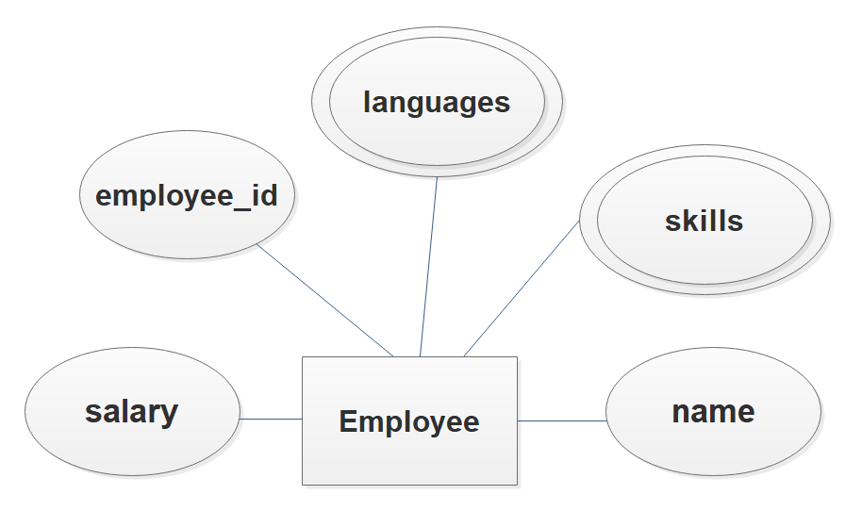
4NF will not be a problem if relationships are modeled properly
4th Normal Form prohibits redundancies
from multi-valued dependencies.
In other words, a row should not contain two or more independent multi-valued facts about an entity.
A determines* multiple values of B;
A determines multiple values of C –
in the same table.
Non-4NF Models will put independent multi-valued attributes in the same table…
perhaps in a table called employee_talents.
emp_id skill language
1 Java English
1 Python Japanese
1 C++
*not functionally determines
4NF Models will put independent multi-valued attributes in different tables…
perhaps emp_skills and emp_languages.
emp_id skill emp_id language
1 Java 1 English
1 Python 1 Japanese
1 C++

Slide 75
emp_skills
Normal Forms
emp_id skill language
1 Java English
1 Python Japanese
1 C++
2 Java Spanish
3 Python
3 Ruby
3 Java
4 C French
4 English
4 Portuguese
Query for employees who speak Spanish? Ok
Query for employees who know Java? Ok
Query for employees who speak Japanese and know C? Requires two joins to this table.
*not functionally determines
1NF?
Yes
2NF?
Yes, no non-prime attributes
3NF?
Yes, no non-prime attributes
BCNF?
Yes, there are no determinants

Slide 76
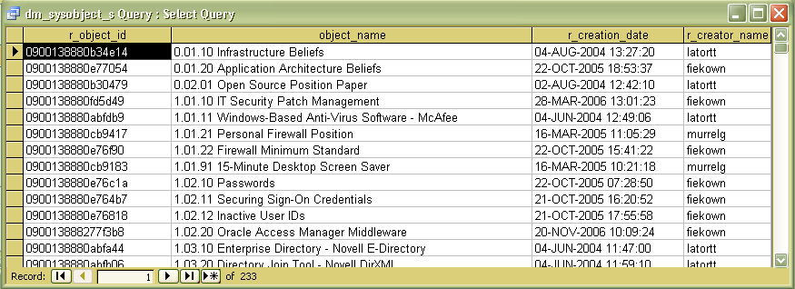
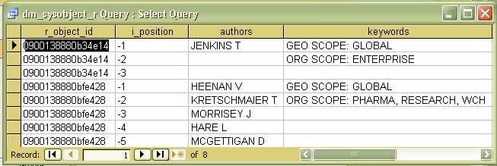
Documentum
Documentum is a high-powered document management system in use in pharmaceutical, oil and gas, financial services, and manufacturing companies.
Here is how they handle the multiple values ofauthors and keywords.
It is not in 4NF.

Slide 77
Going to 5NF
(we’re getting kinda rare here, folks…)
Split table into smaller and smaller tables until all redundancy has been eliminated, but there is no information loss
That is, the denormalized table can be reproduced exactly by joining the smaller tables.
Consider the insurance agent data model
  You can be an agent for multiple companies.
  You can be certified to sell particular types of insurance
  If you represent a company and they offer a type of insurance you are certified for, you must sell that type for them.
InsuranceRegistry
Agent | Company | Offering
Smith | Prudential | Auto
Smith | Prudential | Watercraft
Smith | Prudential | Homeowners
Smith | Liberty Mutual | Auto
Smith | Liberty Mutual | Homeowners
Smith | State Auto | Auto
Smith | State Auto | Homeowners
Brown | Liberty Mutual | Homeowners
Brown | Liberty Mutual | Life
Jones | Prudential | Auto
Jones | State Auto | Auto
Wu | Liberty Mutual | Homeowners

Slide 78
Removal of the Last
Redundancies
Certifications
Agent | Offering
Smith | Auto
Smith | Homeowners
Smith | Watercraft
Brown | Life
Brown | Homeowners
Jones | Auto
Wu | Homeowners
InsuranceRegistry
Agent | Company | Offering
Smith | Prudential | Auto
Smith | Prudential | Watercraft
Smith | Prudential | Homeowners
Smith | Liberty Mutual | Auto
Smith | Liberty Mutual | Homeowners
Smith | State Auto | Auto
Smith | State Auto | Homeowners
Brown | Liberty Mutual | Homeowners
Brown | Liberty Mutual | Life
Jones | Prudential | Auto
Jones | State Auto | Auto
Wu | Liberty Mutual | Homeowners
CompanyOfferings
Company | Offering
Prudential | Auto
Prudential | Homeowners
Prudential | Watercraft
Liberty Mutual | Auto
Liberty Mutual | Homeowners
Liberty Mutual | Life
State Auto | Auto
State Auto | Homeowners
Affiliations
Agent | Company
Smith | Prudential
Smith | Liberty Mutual
Smith | State Auto
Brown | Liberty Mutual
Jones | Prudential
Jones | State Auto
Wu | Liberty Mutual
We already know Smith sells Auto insurance
We already know Brown sells Liberty Mutual

Slide 79
Removal of the Last
Redundancies
Certifications
Agent | Offering
Smith | Auto
Smith | Homeowners
Smith | Watercraft
Brown | Life
Brown | Homeowners
Jones | Auto
Wu | Homeowners
InsuranceRegistry
Agent | Company | Offering
Smith | Prudential | Auto
Smith | Prudential | Watercraft
Smith | Prudential | Homeowners
Smith | Liberty Mutual | Auto
Smith | Liberty Mutual | Homeowners
Smith | State Auto | Auto
Smith | State Auto | Homeowners
Brown | Liberty Mutual | Homeowners
Brown | Liberty Mutual | Life
Jones | Prudential | Auto
Jones | State Auto | Auto
Wu | Liberty Mutual | Homeowners
CompanyOfferings
Company | Offering
Prudential | Auto
Prudential | Homeowners
Prudential | Watercraft
Liberty Mutual | Auto
Liberty Mutual | Homeowners
Liberty Mutual | Life
State Auto | Auto
State Auto | Homeowners
Affiliations
Agent | Company
Smith | Prudential
Smith | Liberty Mutual
Smith | State Auto
Brown | Liberty Mutual
Jones | Prudential
Jones | State Auto
Wu | Liberty Mutual
If the rules change, this doesn’t work….
For example if Smith does not want to (and is not forced to) sell Prudential’s homeowner insurance even though he can.

Slide 80
6th Normal Form
(skinny tables)
Person`
ID | FirstName | LastName | Grade | State
1 | Amber | Robbins | Fr | NJ
2 | Bill | McCauley | Sr | PA
Normalize by “Domain Constraints” – set of allowable values for a column
Elimination of NULLS
Student_Information
ID | Field | Value
1 | FirstName | Amber
1 | LastName | Robbins
1 | Grade | Fr
1 | State | NJ
2 | FirstName | Bill
2 | LastName | McCauley
2 | Grade | Sr
2 | State | PA
Student_First_Names
ID | First_Name
1 | Amber
2 | Bill
Student_Last_Names
ID | Last_Name
1 | Robbins
2 | McCauley
Student_Grades
ID | Grade
1 | Fr
2 | Sr
Student_States
ID | State
1 | NJ
2 | PA
Option 1: Many tables
Option 3: Separate tables only for NULLable attributes (partial 6NF)
Option 2: One tall table*
(*technically, not 6NF)
(also useful for validation codes)

Slide 81
Denormalization

Slide 82
You don't always have to normalize to BCNF
Especially if,
by doing so,
you do not
preserve a dependency.

Slide 83
The Contract Example
Modeled in
schema test
Tables:
  contract
  supplier
  project
  department
  part
Views
  contract_view
A Contract represents an individual agreement that a Supplier will supply a certain quantity of Parts to a corporate Project that is associated with a Department.
contract columns
  ContractID (key)
  SupplierID
  ProjectID
  DeptID
  PartID
  Quantity
  Value
  (of entire contract,
  may be less than
  quantity x unit price)
  All columns in contract dependent on ContractID
  A project purchases a given part only once.
  ProjectID, PartID → ContractID
  To ensure departments don't get unethical kickbacks from a supplier, they can only use a supplier to purchase one part.
  SupplierID, DeptID → PartID

Slide 84
The Contract Example
ContractID | SupplierID | Supplier | ProjectID | ProjectName | DeptID | DeptName | DeptBudget | PartID | Description | UnitCost | Quantity | Value
1 | S12 | Home Depot | 78 | New Conference Center | OPS-101 | Facilities | $72,000 | HD-204 | PVC Tubing | $15.99 | 100 | $1,599.00
2 | S45 | Bruker | 192 | Lab Overhaul | RD-004 | Chemistry | $800,000 | BR-10423 | NMR Spectrometer | $380,000.00 | 1 | $350,000.00
3 | S13 | Amazon | 78 | New Conference Center | OPS-101 | Facilities | $72,000 | A-205 | T Connector | $1.49 | 35 | $52.15
4 | S14 | Lowes | 78 | New Conference Center | OPS-101 | Facilities | $72,000 | L-481 | Floor Tile | $259.00 | 200 | $47,000.00
5 | S14 | Lowes | 192 | Lab Overhaul | OPS-101 | Facilities | $72,000 | L-481 | Floor Tile | $259.00 | 80 | $20,000.00
6 | S20 | Staples | 78 | New Conference Center | OPS-142 | IT | $100,000 | S-1062 | Ethernet Cable | $24.99 | 30 | $749.70
7 | S46 | Beckman | 192 | Lab Overhaul | RD-004 | Chemistry | $800,000 | BK-10424 | UV Spectro-photometer | $9,500.00 | 1 | $9,000.00
8 | S30 | Best Buy | 192 | Lab Overhaul | RD-004 | Chemistry | $800,000 | B-1921 | Desktop Unit | $1,900.00 | 300 | $450,000.00
9 | S13 | Amazon | 78 | New Conference Center | OPS-142 | IT | $100,000 | A-1071 | IP Phone | $280.00 | 80 | $22,400.00
10 | S30 | Best Buy | 78 | New Conference Center | OPS-142 | IT | $100,000 | B-1921 | Desktop Unit | $1,900.00 | 25 | $47,500.00
a

Slide 85
The Contract Example (2)
What are the candidate keys?
ContractID
ProjectID, PartID
ProjectID, SupplierID,
DeptID
What are the non-prime attributes?
Quantity
Value
2NF test. Can they be determined by any subset of candidate key?
Hint: order the view by each subset.
A Contract represents an individual agreement that a Supplier will supply a certain quantity of Parts to a corporate Project that is associated with a Department.
contract columns
  ContractID (key)
  SupplierID
  ProjectID
  DeptID
  PartID
  Quantity
  Value
  (of entire contract,
  may be less than
  quantity x unit price)
  All columns in contract dependent on ContractID
  A project purchases a given part only once.
  ProjectID, PartID → ContractID
  To ensure departments don't get unethical kickbacks from a supplier, they can only use a supplier to purchase one part.
  SupplierID, DeptID → PartID

Slide 86
The Contract Example (2)
What are the candidate keys?
ContractID
ProjectID, PartID
ProjectID, SupplierID,
DeptID
What are the non-prime attributes?
Quantity
Value
3NF test. Are quantity and value directly dependent on all keys?
A Contract represents an individual agreement that a Supplier will supply a certain quantity of Parts to a corporate Project that is associated with a Department.
contract columns
  ContractID (key)
  SupplierID
  ProjectID
  DeptID
  PartID
  Quantity
  Value
  (of entire contract,
  may be less than
  quantity x unit price)
  All columns in contract dependent on ContractID
  A project purchases a given part only once.
  ProjectID, PartID → ContractID
  To ensure departments don't get unethical kickbacks from a supplier, they can only use a supplier to purchase one part.
  SupplierID, DeptID → PartID

Slide 87
The Contract Example (3)
What are the candidate keys?
ContractID
ProjectID, PartID
ProjectID, SupplierID,
DeptID
What are the non-prime attributes?
Quantity
Value
BCNF test. Are all dependencies a candidate key?
A Contract represents an individual agreement that a Supplier will supply a certain quantity of Parts to a corporate Project that is associated with a Department.
contract columns
  ContractID (key)
  SupplierID
  ProjectID
  DeptID
  PartID
  Quantity
  Value
  (of entire contract,
  may be less than
  quantity x unit price)
  All columns in contract dependent on ContractID
  A project purchases a given part only once.
  ProjectID, PartID → ContractID
  To ensure departments don't get unethical kickbacks from a supplier, they can only use a supplier to purchase one part.
  SupplierID, DeptID → PartID

Slide 88
The Contract Example (4)
contract columns
  ContractID (key)
  SupplierID
  ProjectID
  DeptID
  PartID
  Quantity
  Value
  (of entire contract,
  may be less than
  quantity x unit price)
Dept_supplier_usage
columns
  DeptID
  SupplierID
  PartID
To make this BCNF…
Now it is BCNF,
but we've lost the dependency
ProjectID, PartID → ContractID
  All columns in contract dependent on ContractID
  A project purchases a given part only once.
  ProjectID, PartID → ContractID
  To ensure departments don't get unethical kickbacks from a supplier, they can only use a supplier to purchase one part.
  SupplierID, DeptID → PartID
  (key)

Slide 89
The Contract Example (5)
contract columns
  ContractID (key)
  SupplierID
  ProjectID
  DeptID
  PartID
  Quantity
  Value
  (of entire contract,
  may be less than
  quantity x unit price)
Dept_supplier_usage
columns
  DeptID
  SupplierID
  PartID
To preserve
ProjectID, PartID → ContractID
  All columns in contract dependent on ContractID
  A project purchases a given part only once.
  ProjectID, PartID → ContractID
  To ensure departments don't get unethical kickbacks from a supplier, they can only use a supplier to purchase one part.
  SupplierID, DeptID → PartID
project_part columns
  ProjectID
  PartID
  ContractID
  (key)
  (key)

Slide 90
Should you denormalize? (1)
contract columns
  ContractID (key)
  SupplierID
  ProjectID
  DeptID
  PartID
  Quantity
  Value
  (of entire contract,
  may be less than
  quantity x unit price)
Dept_supplier_usage
columns
  DeptID
  SupplierID
  PartID
Query:
Find the quantity of part L-481 in Contract 5.
Requires a join in BCNF, but just a quick scan of the 3NF table.
project_part columns
  ProjectID
  PartID
  ContractID

Slide 91
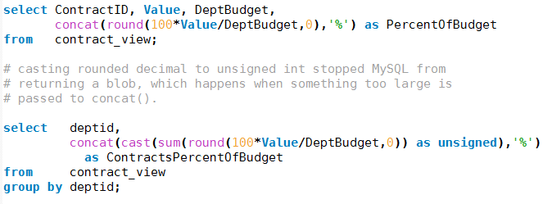
Should you denormalize? (2)
The 3NF form
Query:
How does the value of a contract compare to the department budget?
You could bring deptbudget back into contract. 3NF → 2NF
Requires a join in BCNF, but just a quick scan of the 3NF table.
department
columns
  DeptID
  DeptName
  DeptBudget
contract columns
  ContractID
  SupplierID
  ProjectID
  DeptID
  PartID
  Quantity
  Value

Slide 92
When to denormalize
Murach suggests:
When a column from a joined table is used repeatedly in search criteria.
If a table is updated infrequently
(optimize for retrieval, not frequent data changes)
Include columns with derived values when those values are used frequently in search conditions.
Other ideas:
OLAP (Online Analytical Processing) systems are more frequently denormalized that OLTP (Online Transaction Processing) systems.
Use controlled denormalization if you do denormalize to enforce database integrity in other ways. (e.g., triggers, application pre-processing)

Slide 93
But…
Speaking from long experience, if you don't normalize, you will have duplicates. If you don't have data constraints, you will have invalid data. If you don't have database relational integrity, you will have orphan "child" records, etc. Everybody says "we rely on the application to maintain that", and it never, never does.
A. Lloyd Flanagan, programmer and consultant
My advice?
  3NF has never really let me down.

Slide 94
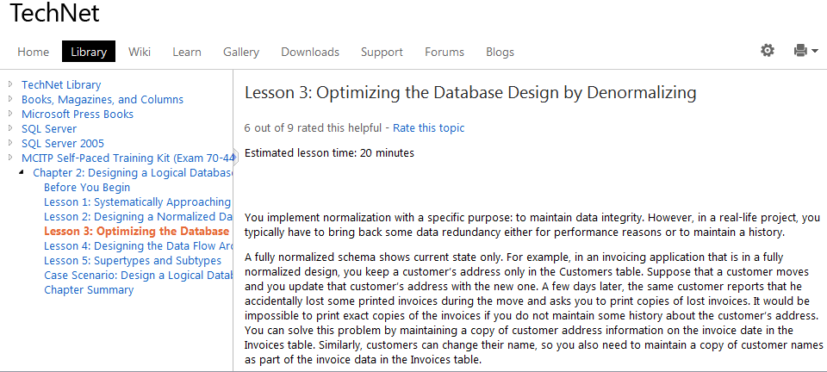
Denormalization
Excellent article on denormalization in Microsoft's TechNet
http://technet.microsoft.com/en-us/library/cc505841.aspx

Slide 95
Supplemental Slides

Slide 96
Back to the Banking Model
branch _name | loan _number | customer _name | amount
Downtown | 17 | Jones | 1000
Redwood | 23 | Smith | 2000
Perryridge | 15 | Hayes | 1500
Downtown | 18 | Johnson | 2000
Assume these
relationships:
customer_name
→ street
customer_name
→ customer_city
loan_number
→ amount
loan_number
→ branch_name
account_number
→ amount
account_number
→ branch_name
customer _name | street | customer _city
Jones | Main | Harrison
Smith | North | Rye
Hayes | Main | Harrison
Johnson | Alma | Palo Alto
branch _name | account _number | customer _name | balance
Downtown | 101 | Johnson | 500
Mianus | 215 | Smith | 700
Perryridge | 102 | Hayes | 400
1NF?
Yes
2NF?
Yes
3NF?
No. customer_
name may not functionally
dependent on
loan_number or
account_number.
Consider joint accounts or loans.

Slide 97
Fix the Model
Now you can have
joint loans and joint accounts
branch _name | account _number | balance
Downtown | 101 | 500
Mianus | 215 | 700
Perryridge | 102 | 400
account _number | customer _name
101 | Johnson
215 | Smith
102 | Hayes
customer _name | street | customer _city
Jones | Main | Harrison
Smith | North | Rye
Hayes | Main | Harrison
Johnson | Alma | Palo Alto
branch _name | loan _number | amount
Downtown | 17 | 1000
Redwood | 23 | 2000
Perryridge | 15 | 1500
Downtown | 18 | 2000
loan _number | customer _name
17 | Jones
23 | Smith
15 | Hayes
18 | Johnson
NOTE: It is customary and STRONGLY encouraged to make the key columns appear
first in a database definition. (Although, technically not required.)

Slide 98
Student Table
ID | First Name | Last Name | Grade | State Of Residence | Primary Contact Phone | Secondary Contact Phone | Graduating High School | GPA | Meal Plan
1 | Amber | Robbins | Fr | NJ | 856-555-1212 | 856-555-2128 | Pilgrim | 2.5 | A
2 | Bill | McCauley | Sr | PA | 610-555-1131 | 610-555-2323 | Murray | 3.7 | C
3 | Cherise | Johnson | Sr | PA | 215-555-2291 | 717-555-8253 | Benton | 3.2
4 | Derek | Brown | Soph | NJ | 856-555-1211 | 856-555-0922 | Pilgrim | 2.9 | A
5 | Elias | Garcia | Jun | NJ | 609-555-2717 | 609-555-0629 | Trellis | 3.1 | A
6 | Fadhi | Singh | Sr | NJ | 856-555-3292 | 856-555-6723 | Central | 3.4
7 | Gwen | Leong | Fr | DE | 302-555-8029 | 302-555-1462 | Murray | 3.3 | B
1NF?
Technically, no. Primary Contact phone and Secondary Contact phone are both contacts.

Slide 99

Sequential Normalization
Make the minimum changes to this table to normalize it to 1NF, then 2NF, then 3NF
Invoice Table
InvoiceNum | Cust Num | Last Name | Street | Item1 | Quant1 | Unit Price1 | Item2 | Quant2 | Unit Price2 | Item2 | Quant2 | Unit Price2
1201 | 15 | Leong | Kent | Glass | 3 | 1.99 | Mug | 3 | 2.09 | Doll | 1 | 15.99
1202 | 21 | Singh | Oak | Keyfob | 12 | .30 | Flag | 1 | 10.99
1203 | 76 | Brown | Main | Thimble | 3 | 1.49 | Pen | 12 | 1.29

Slide 100
1NF
1NF: Remove repeating attributes
Not 2NF. Item depends on InvoiceNum/LineNum
But CustNum depends only on InvoiceNum
Invoice Table
Line Item Table
InvoiceNum
1201
1202
1203
InvoiceNum | Line Num | Cust Num | Last Name | Street | Item | Quant | Unit Price
1201 | 1 | 15 | Leong | Kent | Glass | 3 | 1.99
1201 | 2 | 15 | Leong | Kent | Mug | 3 | 2.09
1201 | 3 | 15 | Leong | Kent | Doll | 1 | 15.99
1202 | 1 | 21 | Singh | Oak | Keyfob | 12 | .30
1202 | 2 | 21 | Singh | Oak | Flag | 1 | 10.99
1203 | 1 | 76 | Brown | Main | Thimble | 3 | 1.49
1203 | 2 | 76 | Brown | Main | Pen | 12 | 1.29

Slide 101
2NF
2NF: Remove Items which depend on a subset of the key.
Not 3NF. LastName and Street depend directly on CustNum, not
InvoiceNum
Invoice Table
Line Item Table
InvoiceNum | Cust Num | Last Name | Street
1201 | 15 | Leong | Kent
1202 | 21 | Singh | Oak
1203 | 76 | Brown | Main
InvoiceNum | Line Num | Item | Quant | Unit Price
1201 | 1 | Glass | 3 | 1.99
1201 | 2 | Mug | 3 | 2.09
1201 | 3 | Doll | 1 | 15.99
1202 | 1 | Keyfob | 12 | .30
1202 | 2 | Flag | 1 | 10.99
1203 | 1 | Thimble | 3 | 1.49
1203 | 2 | Pen | 12 | 1.29

Slide 102
3NF
3NF: Remove Items which indirectly depend on key.
Invoice Table
Line Item Table
InvoiceNum | Cust Num
1201 | 15
1202 | 21
1203 | 76
InvoiceNum | Line Num | Item | Quant | Unit Price
1201 | 1 | Glass | 3 | 1.99
1201 | 2 | Mug | 3 | 2.09
1201 | 3 | Doll | 1 | 15.99
1202 | 1 | Keyfob | 12 | .30
1202 | 2 | Flag | 1 | 10.99
1203 | 1 | Thimble | 3 | 1.49
1203 | 2 | Pen | 12 | 1.29
Customer Table
Cust Num | Last Name | Street
15 | Leong | Kent
21 | Singh | Oak
76 | Brown | Main

Slide 103
Acme College
Acme wants its adjunct professors to teach only one course each term.
Acme students can (naturally) only take one section of a course at a time.
Is the Enrollment table in 3NF? In BCNF? If not, make the table BCNF.
Dependencies
Student → Course? No.
Student → Faculty? No.
Course → Student? No.
Course → Faculty? No.
Faculty → Student? No.
Faculty → Course? Yes.
Student, Course → Faculty? Yes.*
Student, Faculty → Course? Yes
Course, Faculty → Student ? No.
*For each student in a course, there will be only one teacher.
Candidate Keys that uniquely define
a row are in Blue
No non-prime attributes ➔ 3NF
The F→C dependency is not a candidate key,
nor does it contain one ➔ not BCNF
Fall 2013 Enrollment
StudentID | CourseID | FacultyID
1 | CS-101 | 127
1 | CS-121 | 130
2 | CS-101 | 127
2 | CS-121 | 148
3 | CS-101 | 108
3 | CS-121 | 148
4 | CS-121 | 130

Slide 104
Acme College:
The Answer
StudentID | FacultyID
1 | 127
1 | 130
2 | 127
2 | 148
3 | 108
3 | 148
4 | 130
Dependencies
Faculty → Course? Yes.
Student, Course → Faculty? Yes.*
Student, Faculty → Course? Yes
*For each student in a course, there will be only one teacher.
Fall 2013 Enrollment
Boyce-Codd Normal Form
FacultyID | CourseID
130 | CS-121
108 | CS-101
127 | CS-101
148 | CS-121
It works, but is it the best model?

Slide 105
Acme College
StudentID | FacultyID
1 | 127
1 | 130
2 | 127
2 | 148
3 | 108
3 | 148
4 | 130
Dependencies
Faculty → Course? Yes.
Student, Course → Faculty? Yes.*
Student, Faculty → Course? Yes
*For each student in a course, there will be only one teacher.
Queries
Student Amber (1) is taking a class with Professor Smith (127). What is that class?
  select CourseID
  from FacultyCourse
  join StudentFaculty using (FacultyID)
  where StudentID = 1 and FacultyID = 127;
❶
❶
❶
❶
Fall 2013 Enrollment
❶
FacultyID | CourseID
130 | CS-121
108 | CS-101
127 | CS-101
148 | CS-121
Find Student 1 in the StudentFaculty table
Do any of these rows have Faculty 127?
Lookup what Faculty 127 teaches.
❶
LOGICAL !
Relationship is modeled.

Slide 106
Acme College
StudentID | FacultyID
1 | 127
1 | 130
2 | 127
2 | 148
3 | 108
3 | 148
4 | 130
Dependencies
Faculty → Course? Yes.
Student, Course → Faculty? Yes.*
Student, Faculty → Course? Yes
*For each student in a course, there will be only one teacher.
Queries
Student Bill (2) is taking CS-121. Who is teaching it?
  Select FacultyID
  from FacultyCourse
  join StudentFaculty using (FacultyID)
  where StudentID = 2 and CourseID = 'CS=121';
?
❷
❷
Fall 2013 Enrollment
❷
FacultyID | CourseID
130 | CS-121
108 | CS-101
127 | CS-101
148 | CS-121
❷
Find Student 2 in the StudentFaculty table
Do any of these rows have CS-121?
Hmm…wait, I had better join first.
Do any of these rows have CS-121?
Does Bill have this instructor?
Hard to follow
Relationship is NOT modeled.
❷

